Slide 1
Quiz Test
A training course for GIS developers
…
Prepared by GIS Co., Ltd.

Slide 2
Course Outlines – Prerequisites
ArcGIS API for JavaScript >= 4.X or newer
Angular Version >= 13.X or newer
NodeJS >= 14.X.X or newer

Slide 3
The Shelters
The best things in life are rescued.

Slide 4
Quiz #1
Landing Page

Slide 5
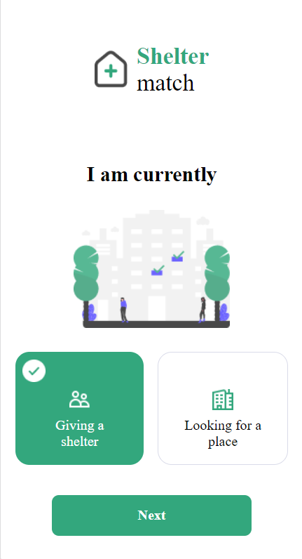
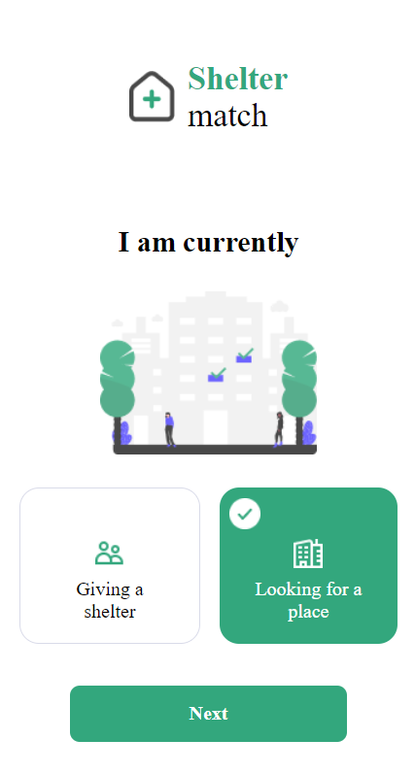
Quiz #1 – Landing Page
Assets
Download here: https://github.com/gisc5029/QuizAssets
1.1 Implement UI of landing page as below
logo.png
bg1.png
chkbox.png
renting.png
looking.png
Looking_active.png
renting_active.png
#33A77D

Slide 6
Quiz #1 – Landing Page
1.2 Implement Angular Routing
Go to “register” page
Go to
“search” page

Slide 7
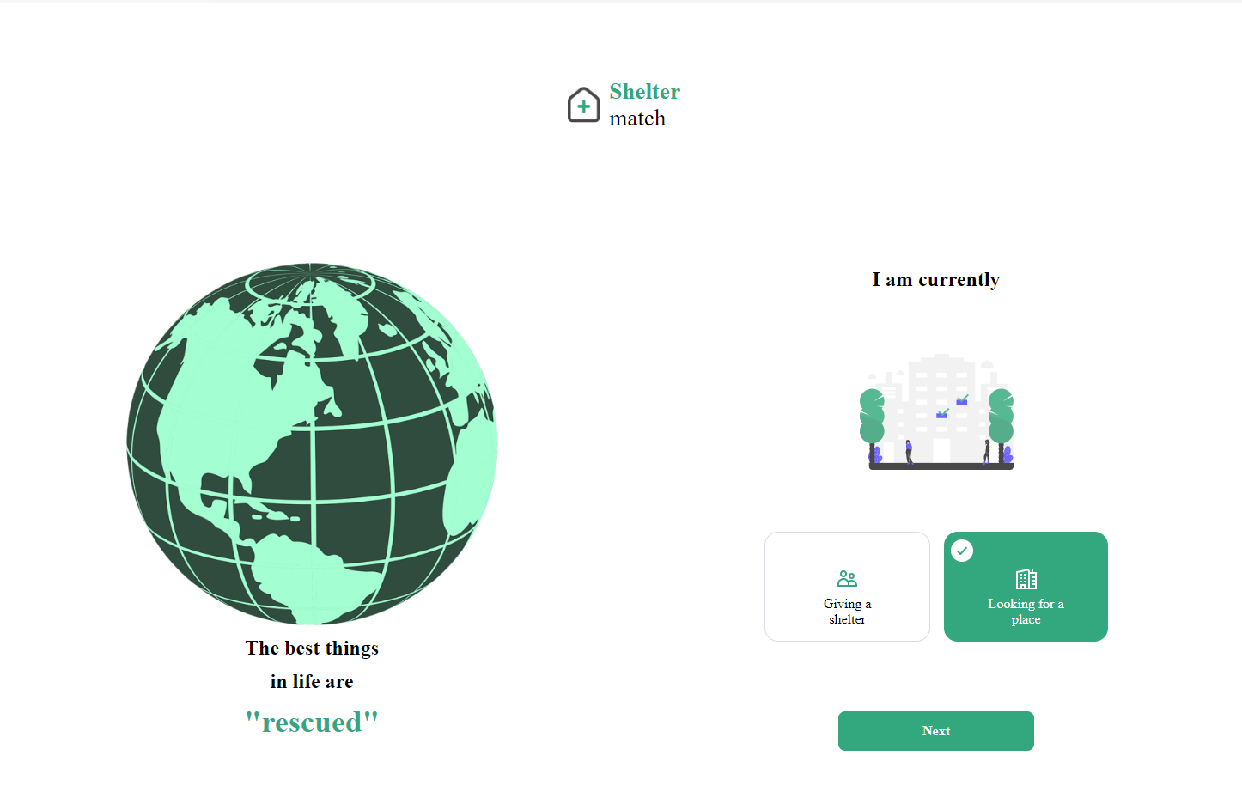
Quiz #1 – Landing Page
1.3 Implement Web Responsive
Responsive View
: Width >= 1024

Slide 8
Quiz #1 – Landing Page
Goal of Quiz#1
Test basic of implementing UI.
Test basic of angular
Handling state of element/control
Angular routing
Test basic of implementing web responsive
*** Functionality > Beautiful UI

Slide 9
Quiz #2
Register Page

Slide 10
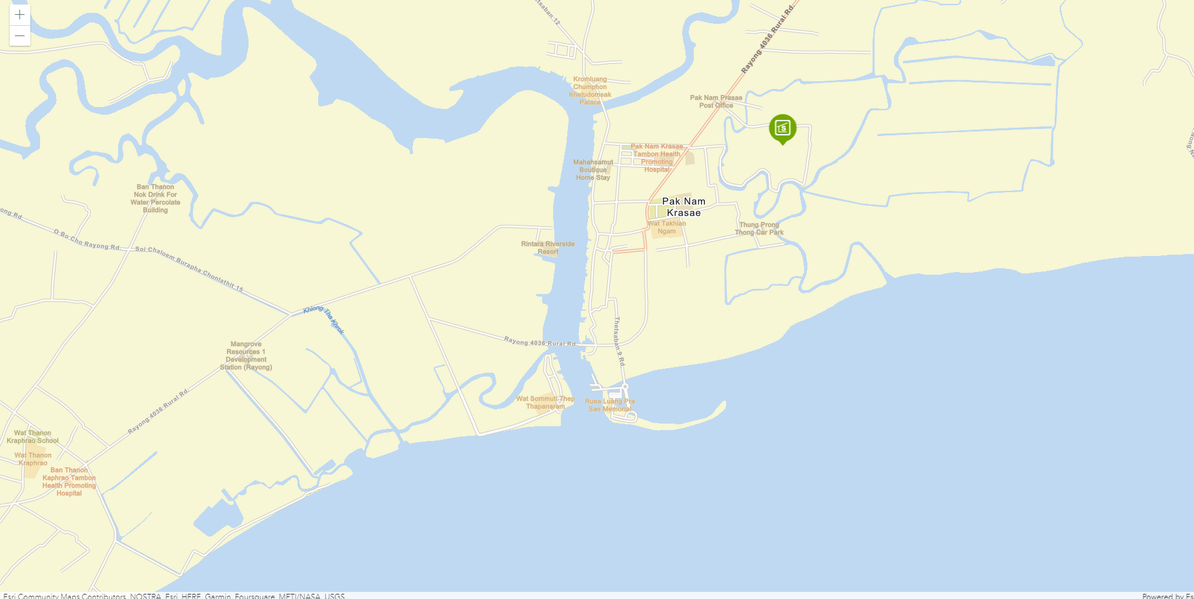
Quiz #2 – Register Page
2.1 Display Map on Register Page
Map Initial:
Center At
- [101.704, 12.704]
Zoom level
- 14

Slide 11
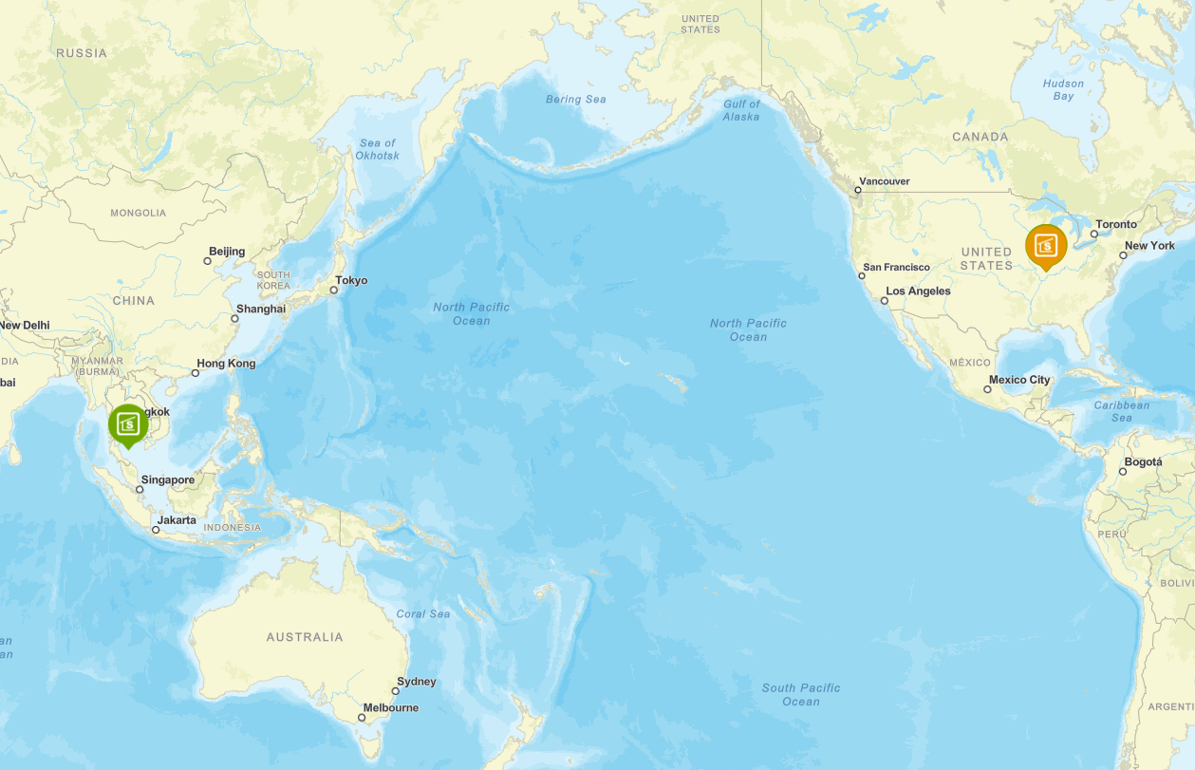
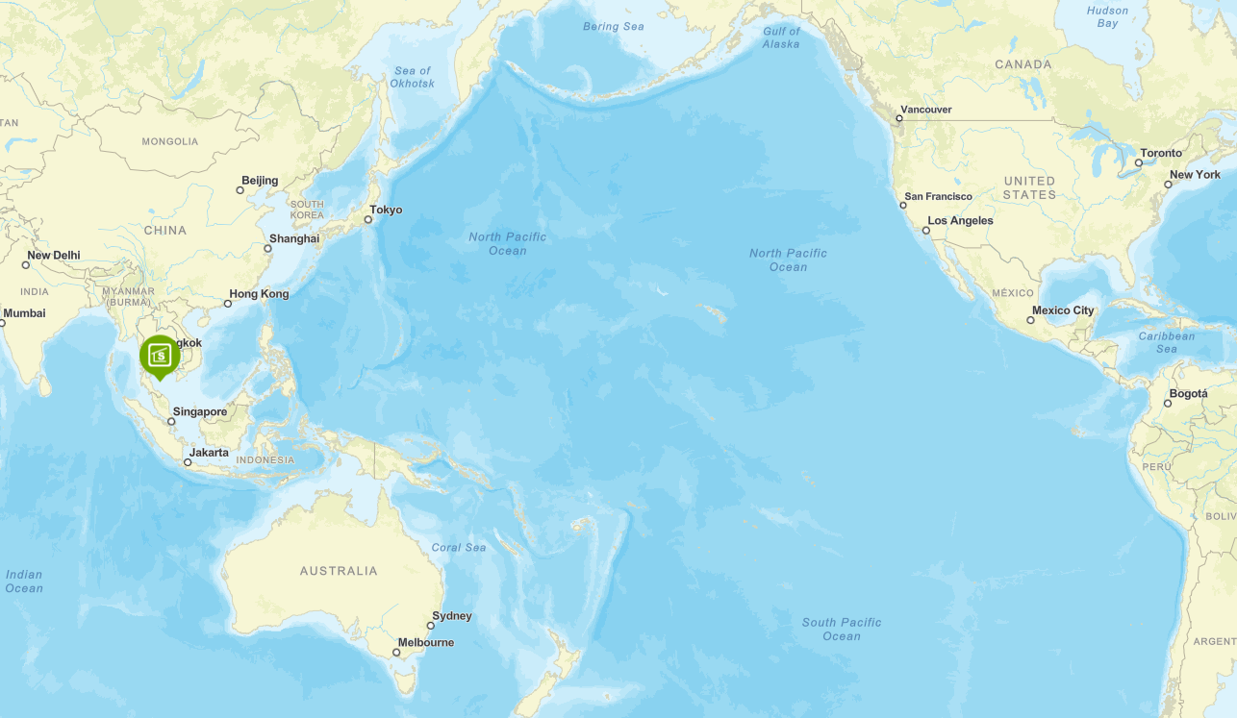
Quiz #2 – Register Page
Map Service: https://sampleserver6.arcgisonline.com/arcgis/rest/services/NapervilleShelters/MapServer
Feature Service: https://sampleserver6.arcgisonline.com/arcgis/rest/services/NapervilleShelters/FeatureServer/0
2.2 Display “NapervilleShelters” Map Service on Specific Condition
- Only display data that has attributes: “organiz” = 'GISC'
Only “organiz” = 'GISC'

Slide 12
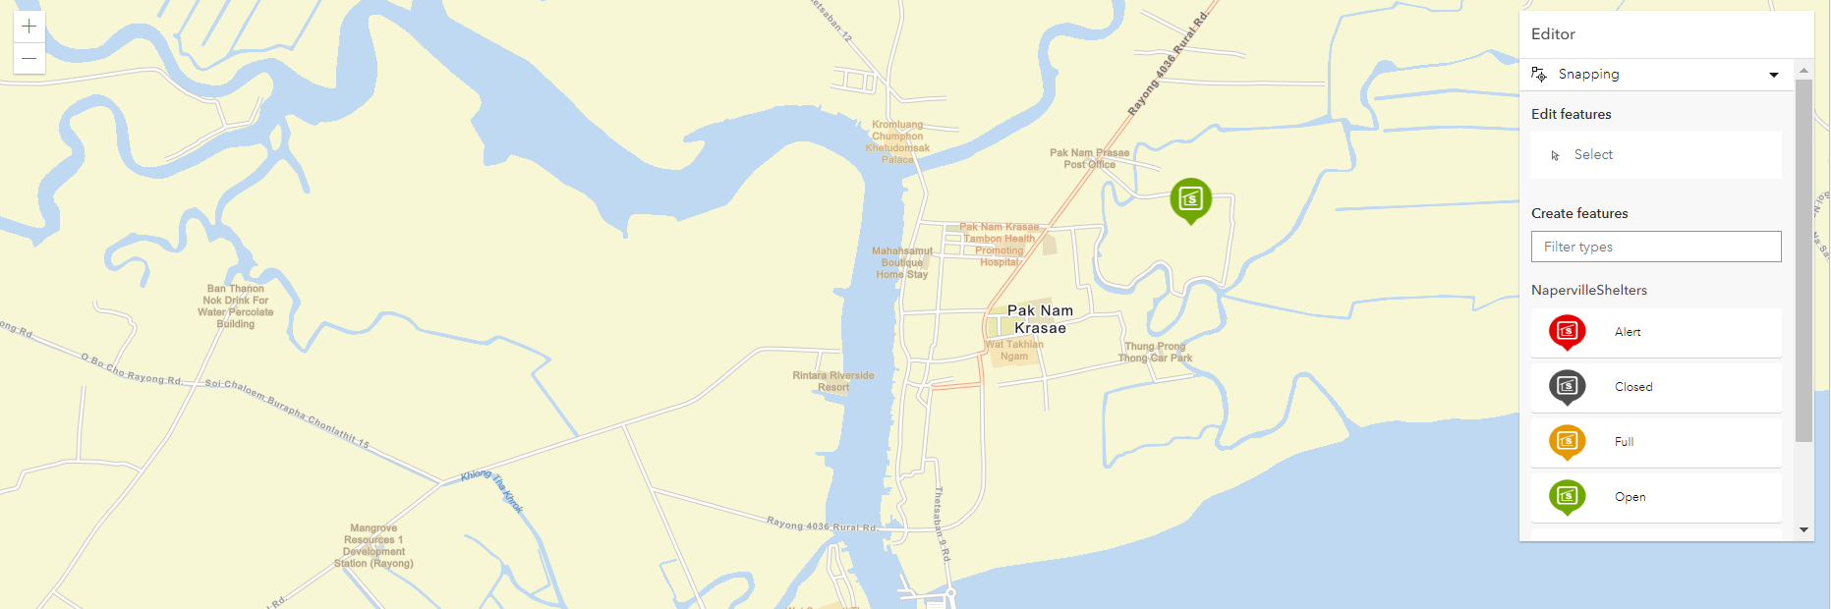
Quiz #2 – Register Page
2.3 Implement Create, Update and Delete on NapervilleShelters Service
By using Editor Widget
- https://developers.arcgis.com/javascript/latest/api-reference/esri-widgets-Editor.html

Slide 13
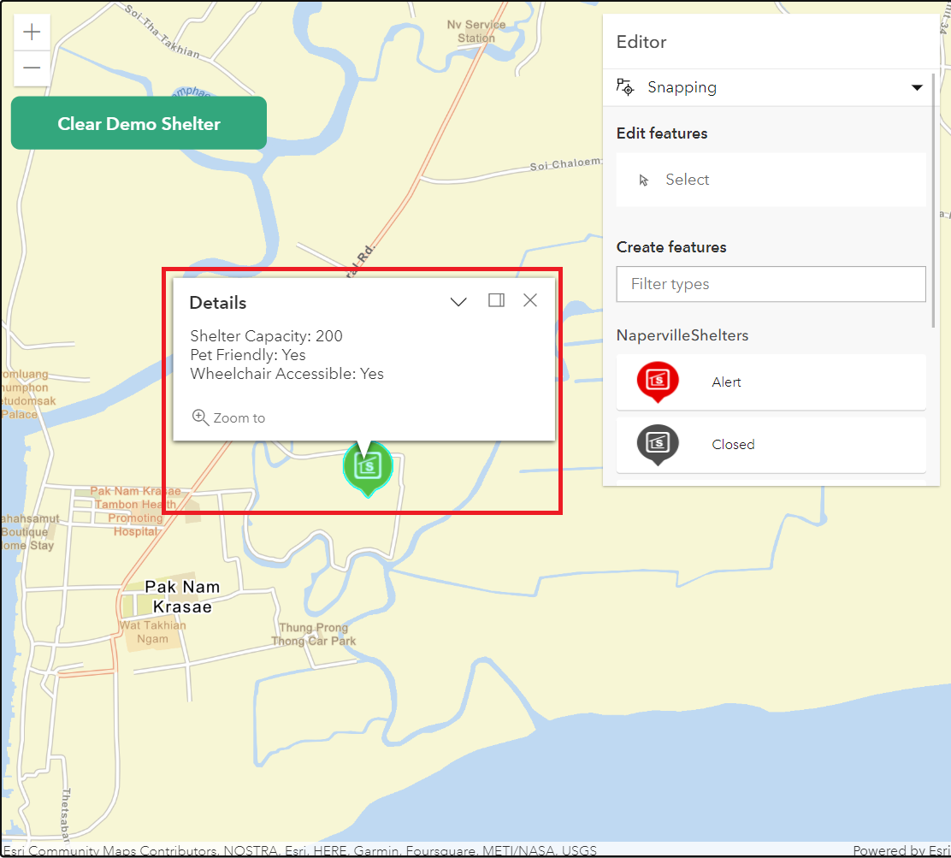
Quiz #2 – Register Page
2.4 Click the feature to display a popup
Display popup with the following attributes: Shelter Cap, Pet Friendly, Wheelchair Accessible

Slide 14
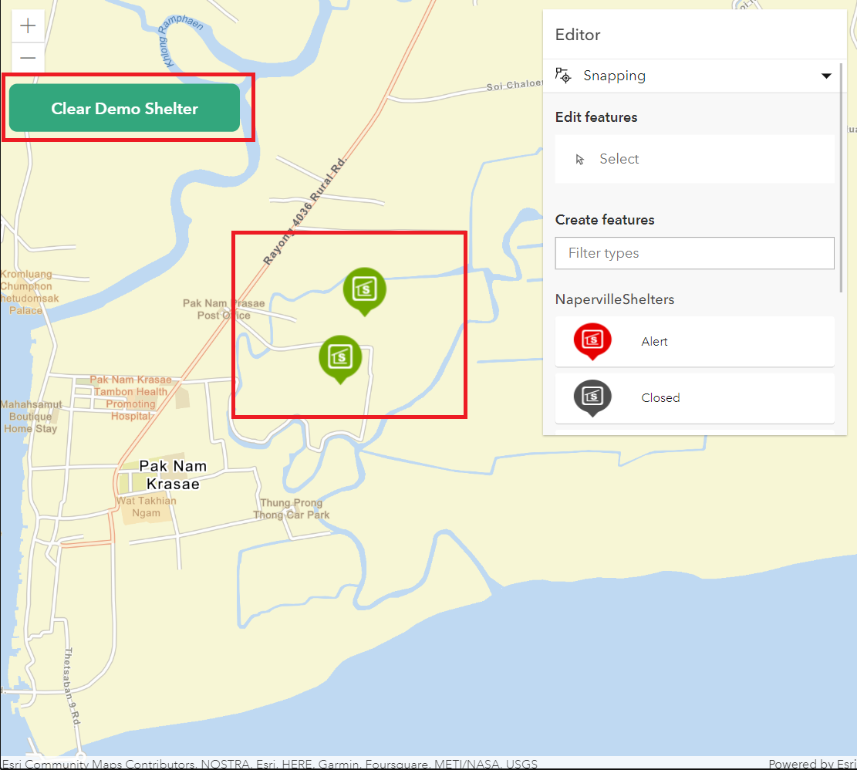
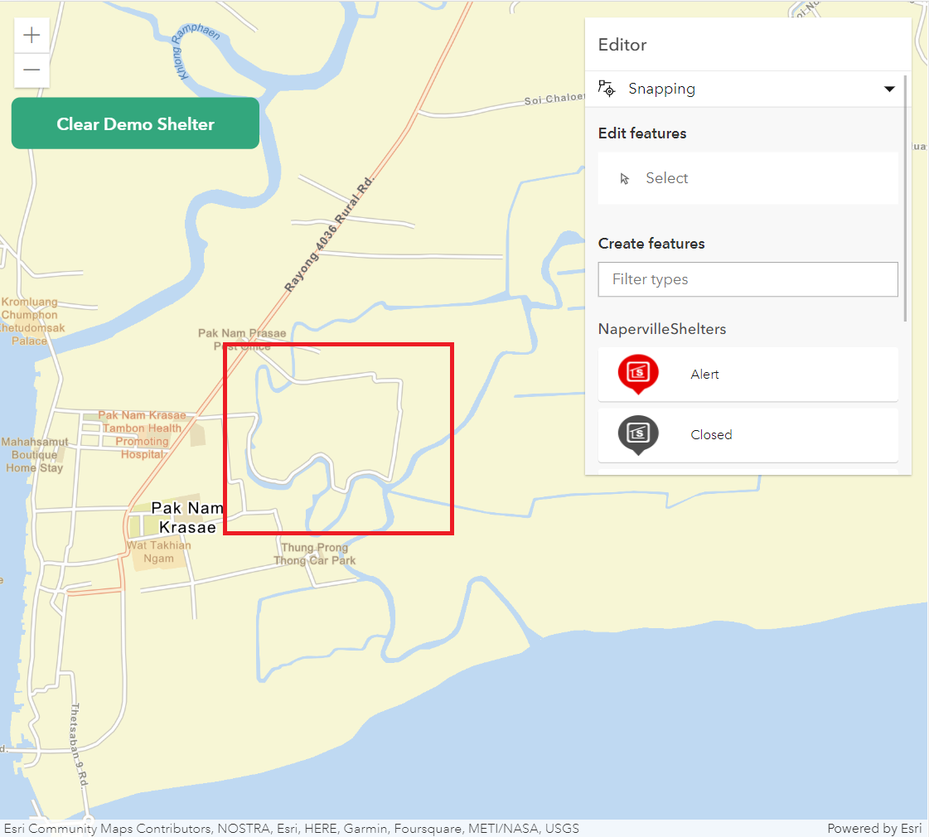
Quiz #2 – Register Page
2.5 Implement Clear Button to remove demo data from feature service.
- remove all data that has attributes: “organiz” = 'GISC'

Slide 15
Quiz #2 – Register Page
Goal of Quiz#2
Test basic of ArcGIS API for JavaScript
Map and Layer Concept.
Be able to use the widget of API.
Be able to use the operation of feature services via API.
Be able to use the popup template
*** Functionality > Beautiful UI

Slide 16
Quiz #3 (Extra)
Search Page

Slide 17
Quiz #3 – Search Page
3.1 Display Map on Register Page
Map Initial:
Center At
- [101.704, 12.704]
Zoom level
- 14

Slide 18
Quiz #3 – Search Page
Map Service: https://sampleserver6.arcgisonline.com/arcgis/rest/services/NapervilleShelters/MapServer
Feature Service: https://sampleserver6.arcgisonline.com/arcgis/rest/services/NapervilleShelters/FeatureServer/0
3.2 Display “NapervilleShelters” Map Service on Specific Condition
- Only display data that has attributes: “organiz” = 'GISC'
Only “organiz” = 'GISC'

Slide 19
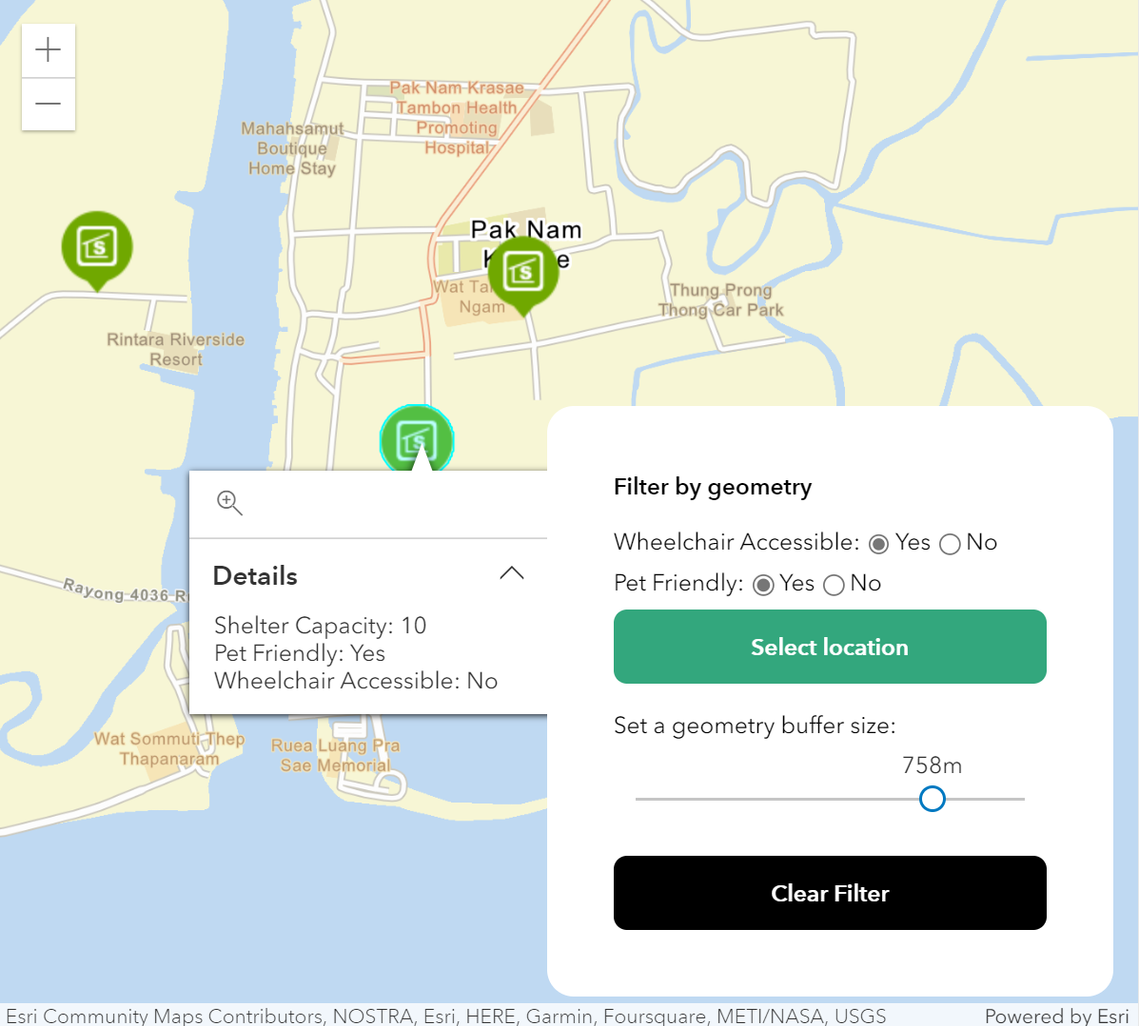
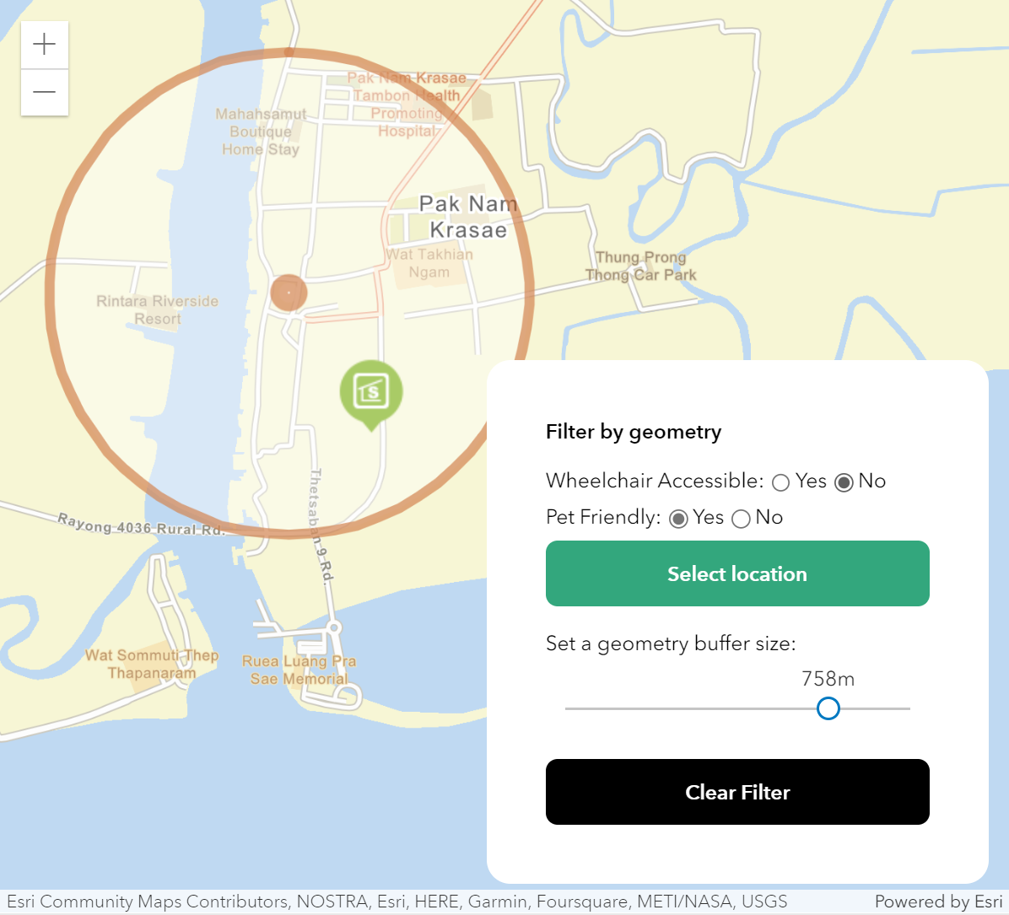
Quiz #3 – Search Page
3.3 Implement Search Filtering Panel
- Click the “Select Location” and Click on “Map” to draw a buffer and filter data that meet the specific condition on Search Filtering Panel (**Buffer Size minimum = 0 meters, maximum = 1000 meters)

Slide 20
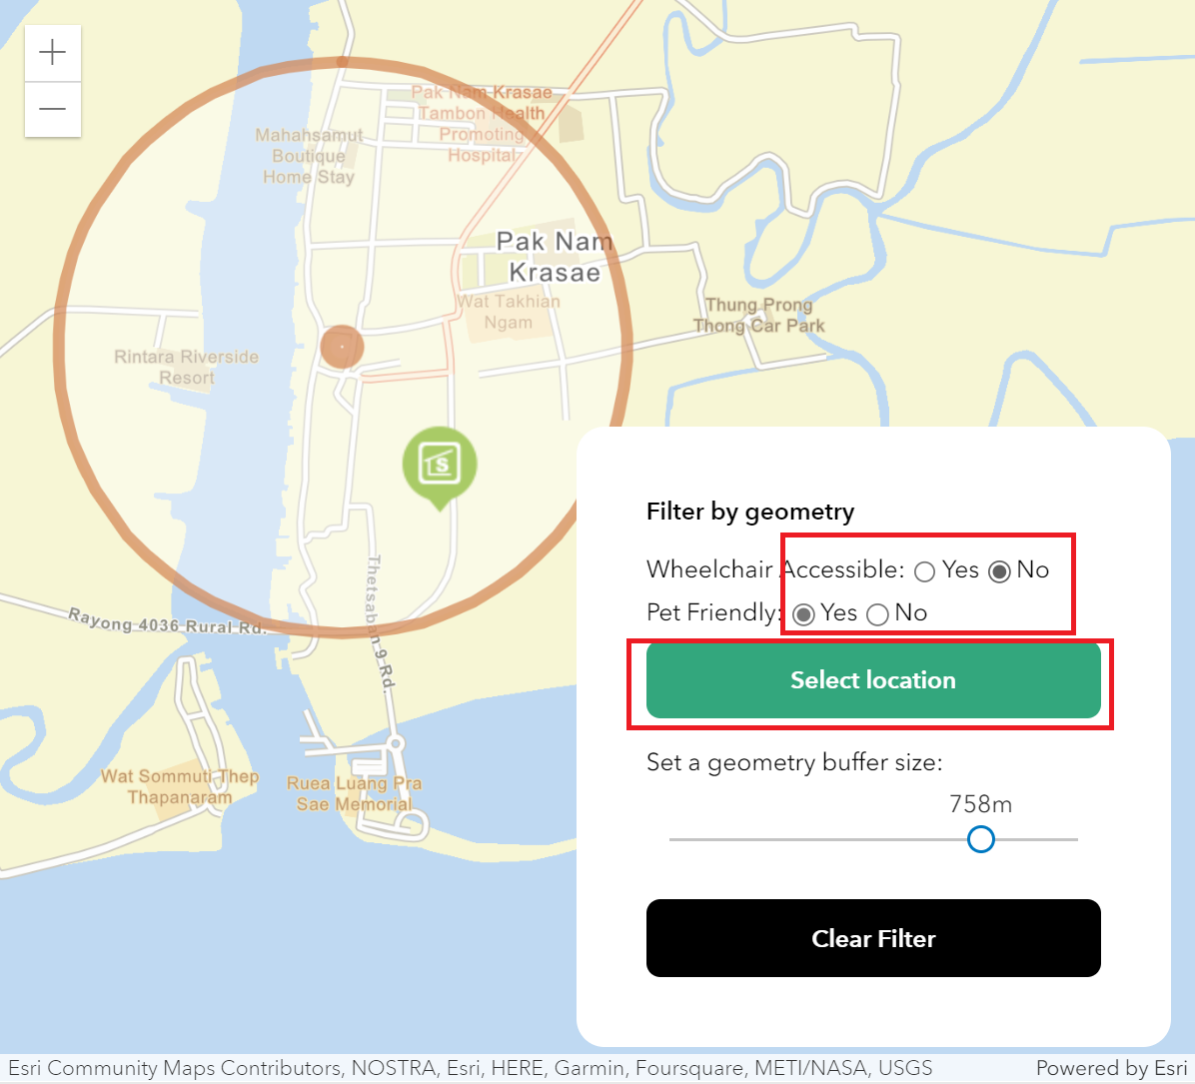
Quiz #3 – Search Page
Use case: Search Filtering Panel
Wheelchair: Yes
PET: Yes
Wheelchair: Yes
PET: No
Wheelchair: No
PET: Yes

Slide 21
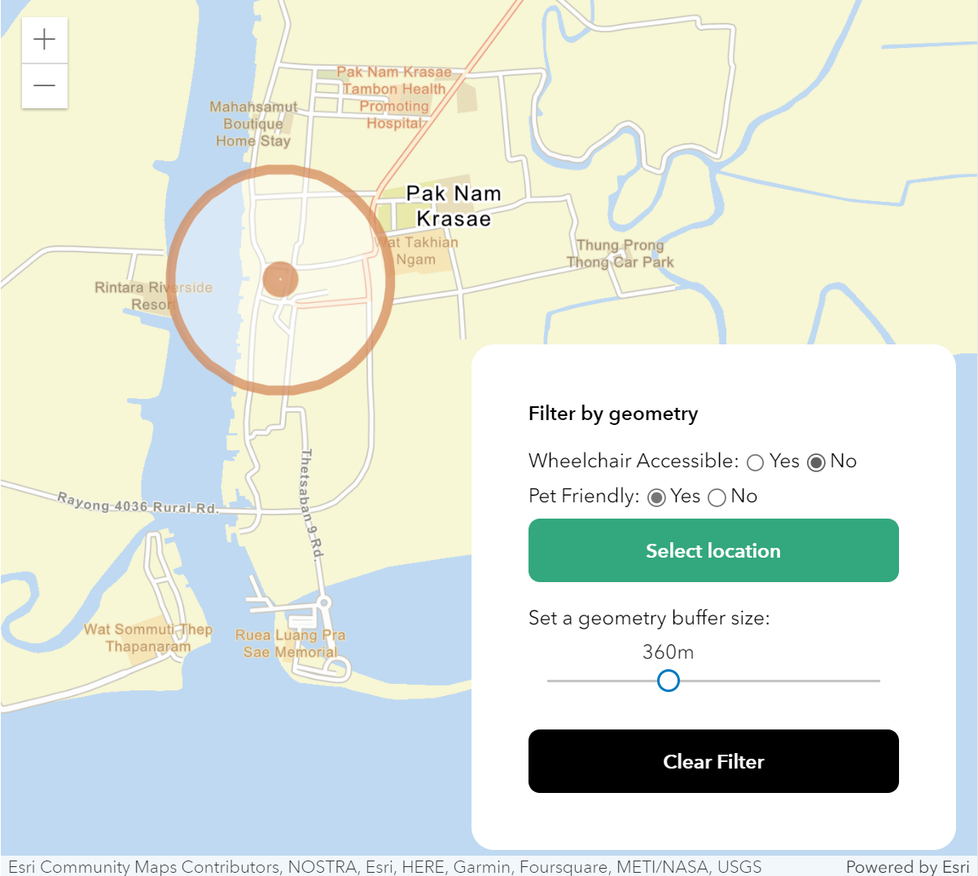
Quiz #3 – Search Page
Use case: Search Filtering Panel
Small Buffer without result

Slide 22
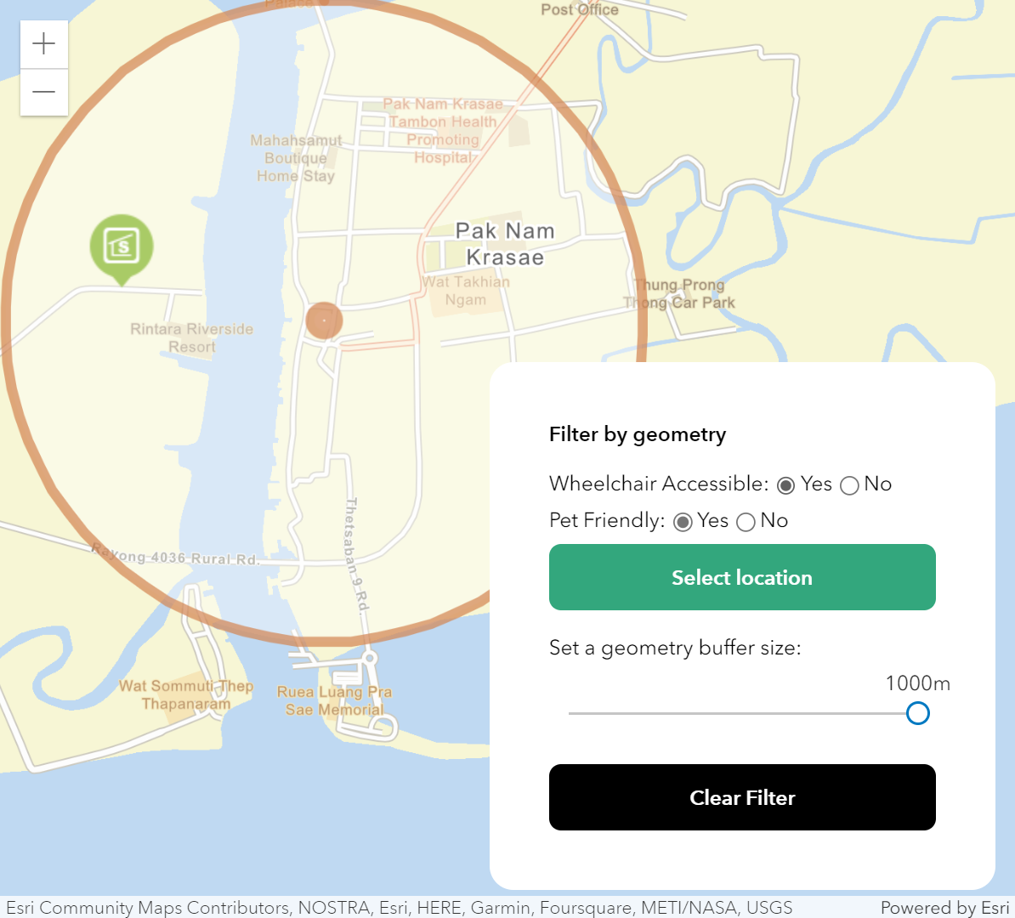
Quiz #3 – Search Page
Use case: Search Filtering Panel
Rgba: [211, 132, 80, 0.7]
Rgba: [255, 255, 255, 0.4]
Rgba: [211, 132, 80, 0.7]
Larger Buffer with result

Slide 23
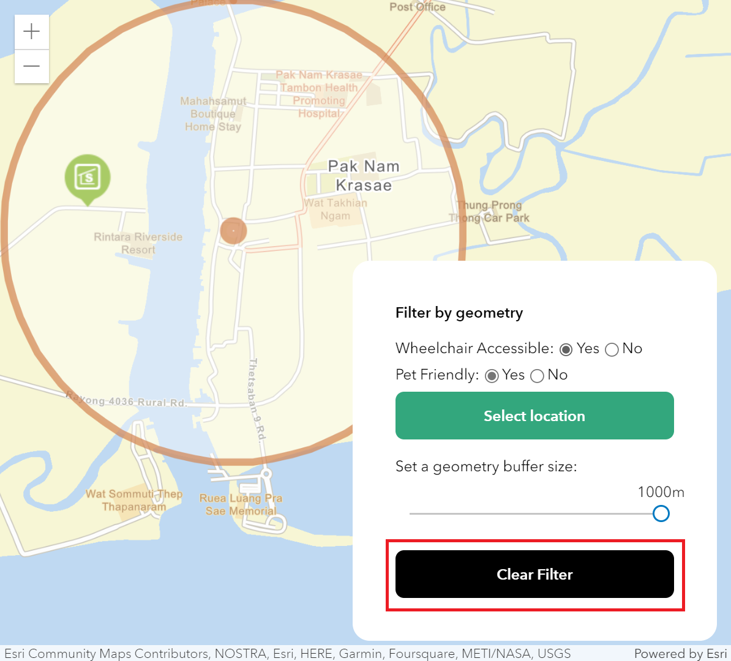
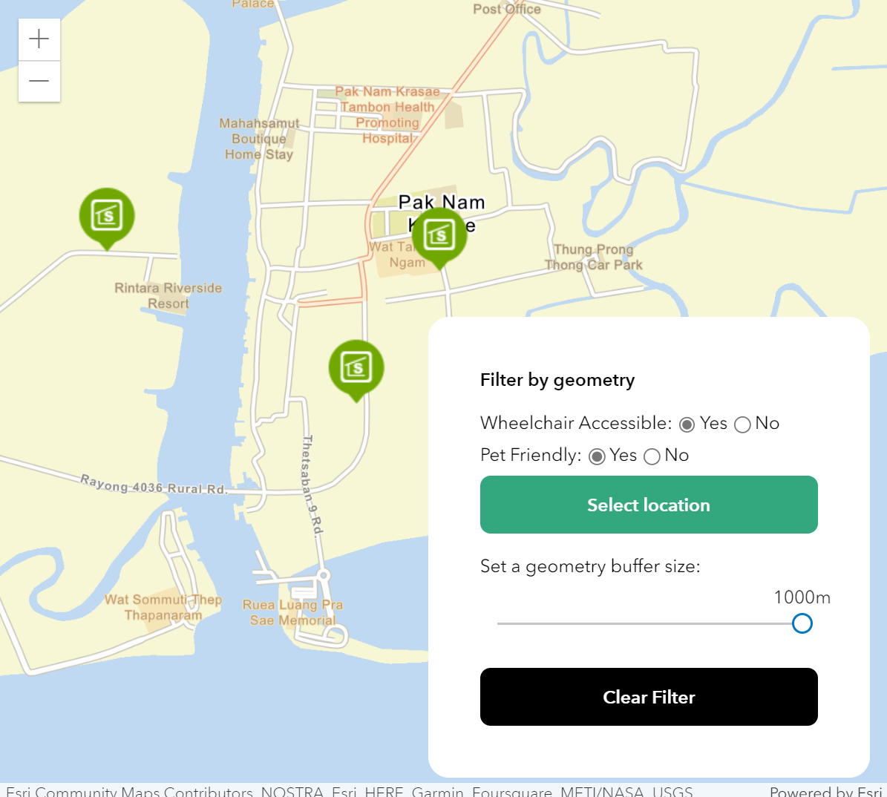
Quiz #3 – Search Page
3.3 Implement Search Filtering Panel
- Click the “Clear Filter” to remove the buffer graphic and remove layer filter condition.

Slide 24
Quiz #3 – Search Page
Goal of Quiz#3
Test intermediate skill in using ArcGIS API for JavaScript
*** Functionality > Beautiful UI

Slide 25

Everyone must join Open Chat
Room: "GISC Quiz #1452“
https://line.me/ti/g2/x-5BHzljhVJjyvuqzOfi4_GaZAi-M6uMdMqWPw?utm_source=invitation&utm_medium=link_copy&utm_campaign=default

Slide 26
Everyone must create a personal meeting and invite chanon.t@cdg.co.th and noppadon.h@cdg.co.th to join your meeting.

Slide 27
share the screen when doing a quiz.

Slide 28
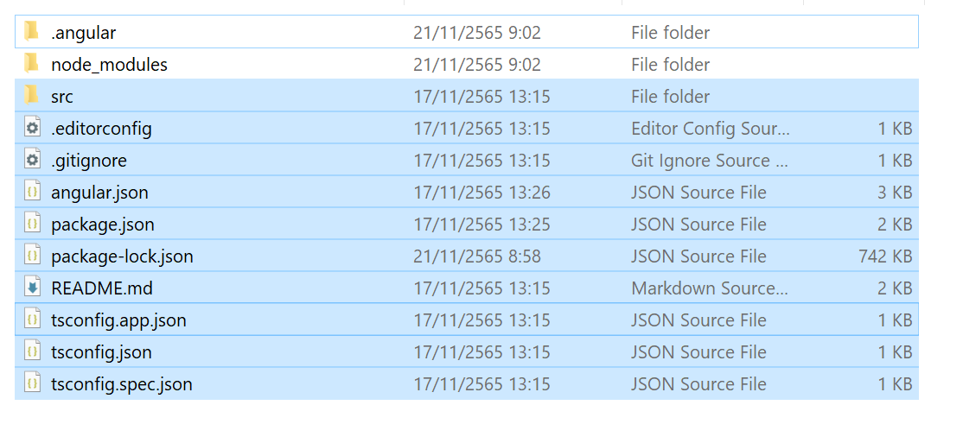
After time up zip source code and sent to email: 005029@cdg.co.th
* Do not include “node_modules” or “.angular” in the zip file.

Slide 29
END

